Slide 1
Git
For NORMAL developers

Slide 2

Joseph Reynolds
Principal Software Engineer Surge
Lonestar College IT Advisory Board Chair, 2010 – present
North Houston .Net User Group Board Member, 2011 – present
Microsoft C# MVP 2013 – 2018
Enjoys reading, role-playing games, and spending time with family.

Slide 3
Agenda
Git Basics
Git Repos – GitHub, BitBucket, VSTS
Branching, Merging, and How to stay sane.
Common UI Tools

Slide 4
Git Basics

Slide 5

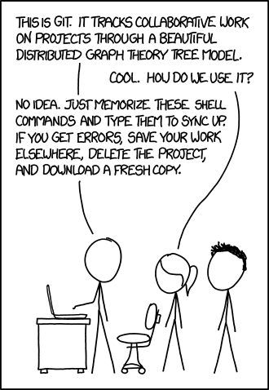

Slide 6
These are BASICS!!!
I’m really not a Git Guru.
I don’t really know how the SHA-1 Hashes are computed. Nor do I care.
I don’t know why Snapshot differences are better than Delta differences… I just know it works, and makes my life easier.
I will try to give you some places to find more in-depth answers!

Slide 7
Terms
Clone
Make a local copy of another repository.
You can clone local repositories – but this is usually done to bring a remote repository to your local workspace.
Stage
Tells git that you have changes you want to commit.
Can be used to “stage” small subsets of changes, making it obvious that they are related.
Can be “unstaged”.
Can stage portions of files as well as a full file.
Commit
Tells git to save the changes and make an entry in the log.
Can be reversed.
Requires a message describing the change.
Fetch
Gets information from the remote source about what is different between you and the remote.
Does not actually perform a merge operation.

Slide 8
Terms
Pull
Merges changes on the remote repository with your local repository.
Push
Replicates your changes to the remote repository.
Sync
If you do a push and a pull, you have synced the repositories.
Pull Request
A request to take a forked branch and merge it back to an upstream branch. For instance, merging a feature branch into master.
This provides a chance for others to review the code, make comments, and revise the code before it is merged.

Slide 9
Terms
Merge
A way of bringing the commits on one branch into another branch
Results in a “Merge Commit”
Generally the preferred way to synchronize branches
Rebase
An alternative to merge
Brings the tip of one branch to the end of the other

Slide 11
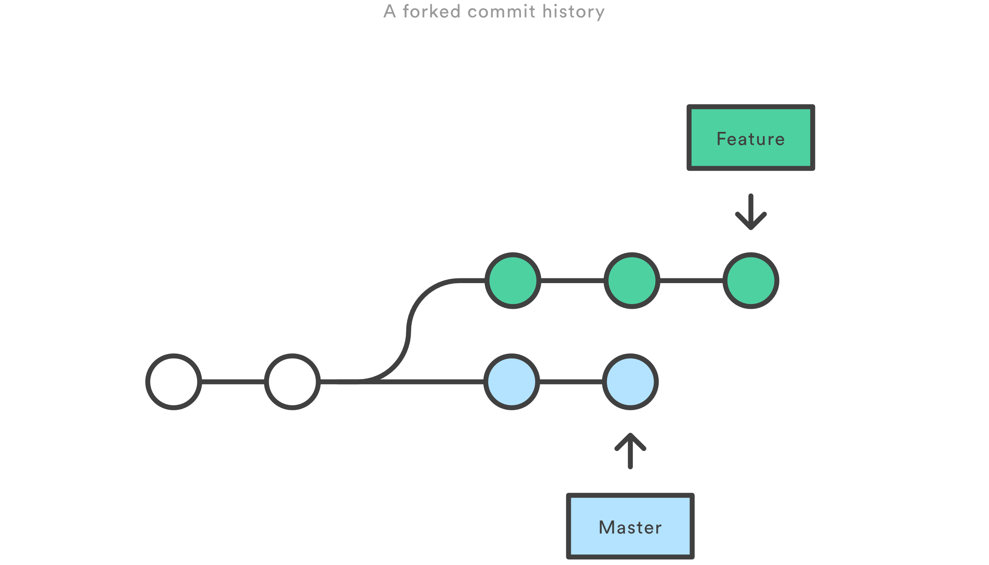
Branching

Slide 12
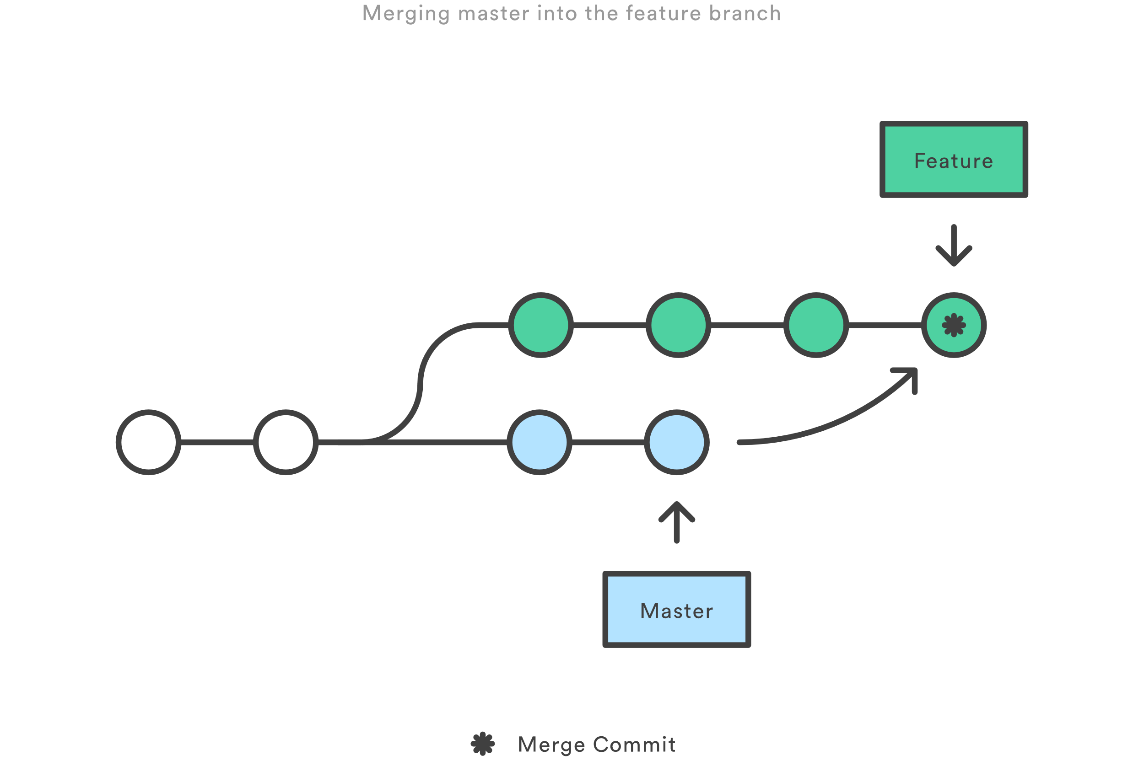
Merging

Slide 13
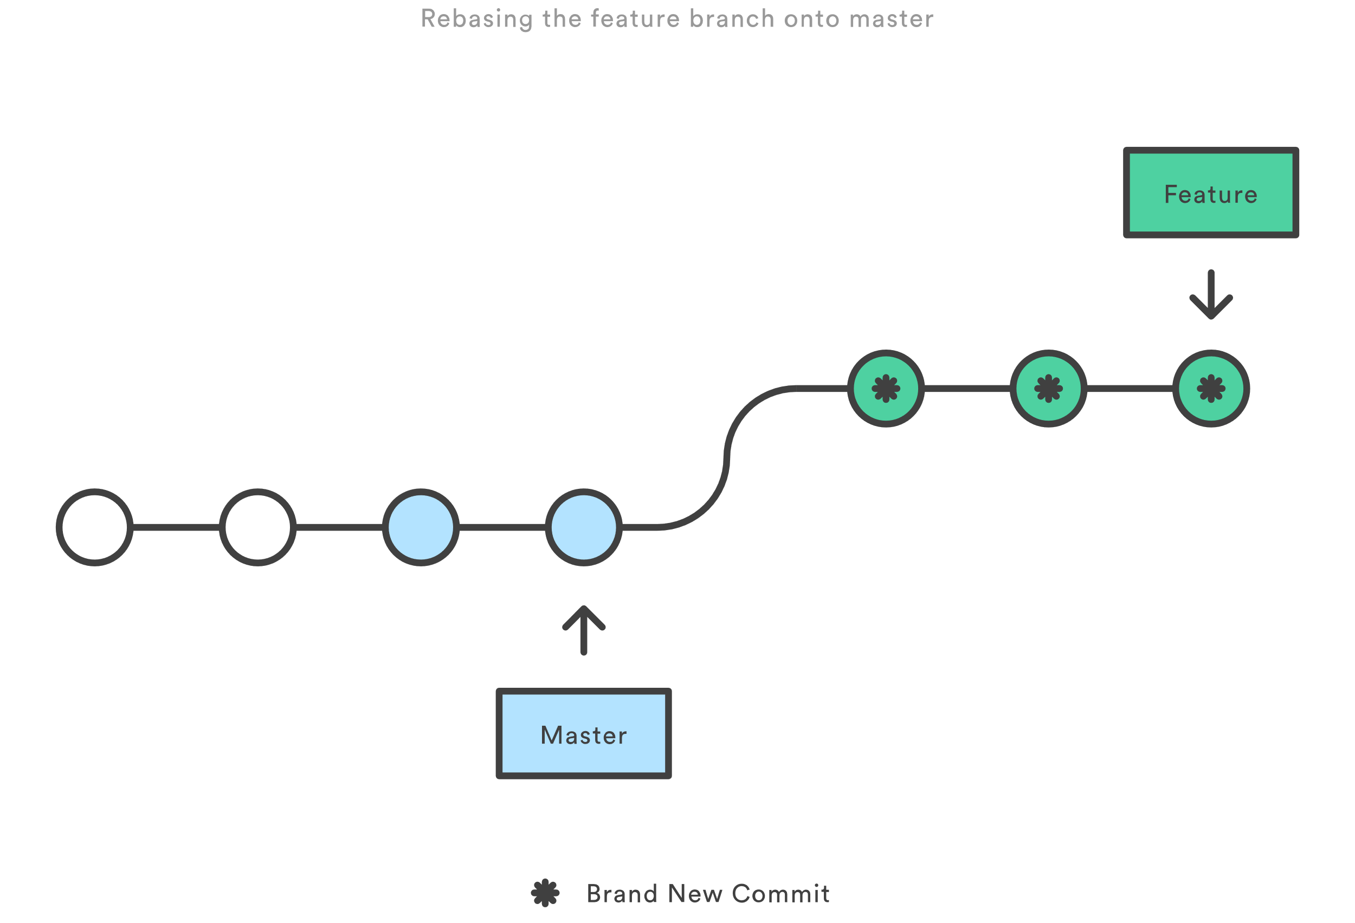
Rebasing

Slide 14
Best practice
Don’t ever rebase onto a public branch
Honestly, probably stick to merge unless your team has clear guidelines on when to rebase

Slide 15
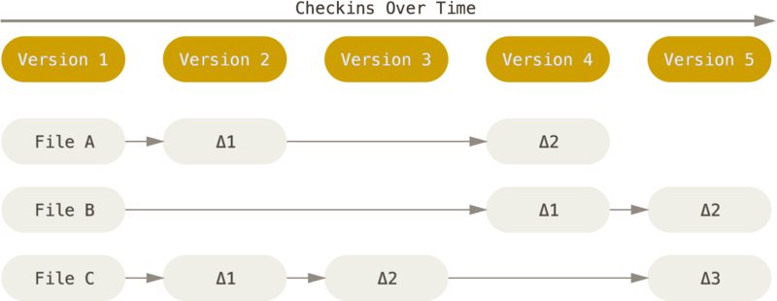
Snapshots – Not Diffs
Most Version Control Systems (VCS) track differences.

Slide 16
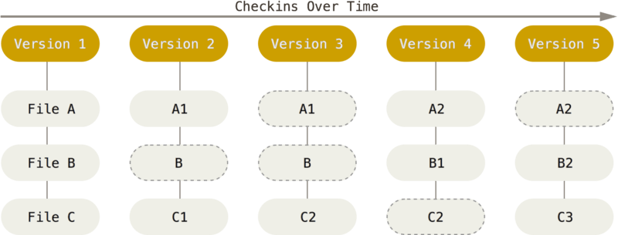
Snapshot – Not Diffs
Git tracks a snapshot of the file – only tracking changed files.

Slide 17
Local Operations
Git keeps the full repo on your local computer
Commits, Log operations, branching\merging – it’s all local
Only the initial checkout, and synchronizing your branch is done remotely!
(Well, pull requests too, sort of, but that’s a deeper topic!)
This means you can work offline, in a distributed scenario. No file locks, checking the central server, or being blocked by bad internet access!

Slide 18
Git has Integrity
The SHA-1 thing I mentioned earlier?
Git computes a SHA-1 Hash of the commit you just made, and it makes it so you can’t make changes to watched files without Git knowing about it.
How? I dunno. Magic probably.

Slide 19
Git is recoverable
Git generally only *adds* data.
There’s a couple things you can do that are un-undoable, probably, but I haven’t found them yet.
Once you commit a change, you can always go back and access it. If you mess something up, you can revert to a previous change-set, and you’re good to go!

Slide 20
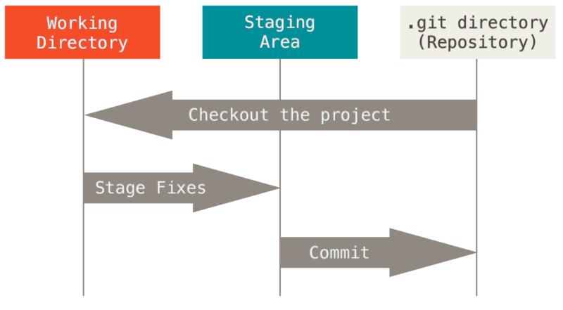
Basic Workflow
(Clone)

Slide 21
Three States
Modified
You’ve made a change to one or more files.
Staged
You’ve gone through and selected the files you want to commit
You don’t HAVE to commit everything in one go!
Committed
Committing is the part that is recorded to Git. It’s now part of the log and can be seen in the history.

Slide 22
Not quite done - probably
In most cases, you still need to synchronize your code with a shared repository.
This is known as a “Push”
Getting code from the central repo is known as a “Pull”
If you both “Pull” and “Push” – you have “synced” your code.

Slide 23
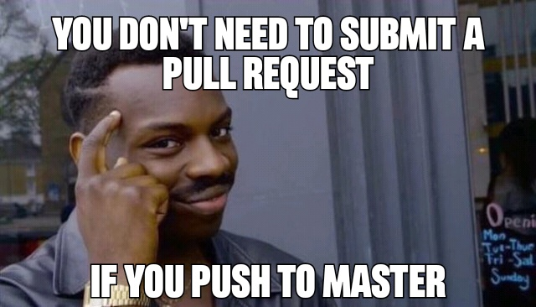

Slide 24

Hosted Git Repos
Sharing the code!

Slide 25

Repos
Big 3
Azure Devops
Known for closed source projects
High-End CI/CD functionality
Exceptional project tracking via TFS
GitHub
Known for open source projects
Exceptional bug-tracking and messaging
API works well with most CI/CD platforms, Team City, Jenkins, TFS, etc.
BitBucket

Slide 26
Azure Devops
Free up to 5 users
Unlimited private repos
No public repositories! Public Repositories are in preview as of this writing.
CI/CD pipeline is well developed – no Team City necessary, Octopus Deploy is debatable.
Azure is well integrated – great for websites, services, mobile, etc
Great choice for small business!
Learning Curve: Experience with MS products makes this easy-ish

Slide 27
Github
Most widely used hosting platform
Unlimited public repositories
$7/month personal account with unlimited private repositories
Enterprise plans allow on-premises hosted solutions.
Learning Curve: Experience with Git helps make this easy-ish
EVERY DEVELOPER SHOULD HAVE A GITHUB PROFILE
Host code you’re proud of
Fork someone else’s code and make a change
It’s as good as or better than a resume!

Slide 28
BitBucket
Free up to 5 users
Unlimited public repositories
Unlimited private repositories
Pricing beyond 5 users is roughly $1/month/user

Slide 29
Host roundup
Choose Github for your open-source, publicly-viewable projects
Choose Azure Devops for company projects, or for running the CI/CD builds on your GitHub repo (Yes, you can do BOTH!)
BitBucket offers a nice alternative to Github, but is not as well known. Mileage may vary.
AWS is offering some interesting new options

Slide 30
Strategies
How to stay sane

Slide 31
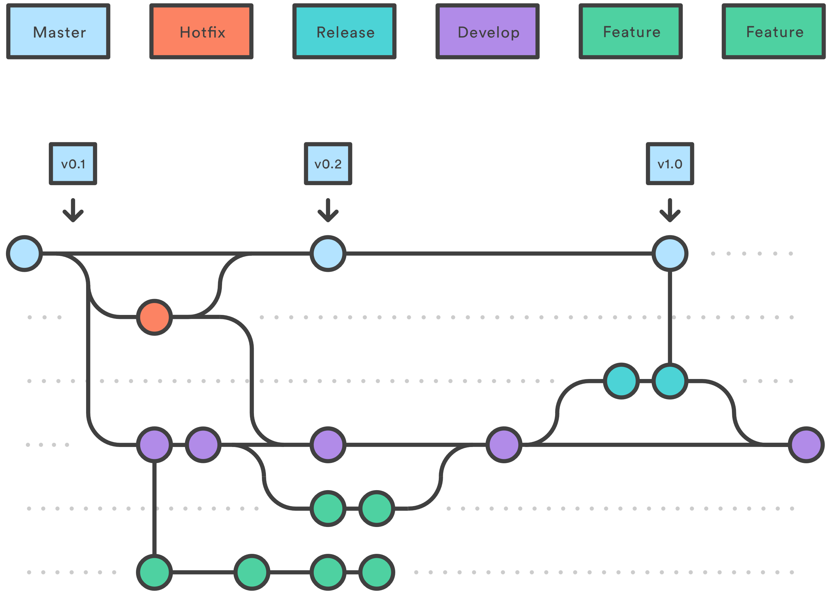
Gitflow

Slide 32
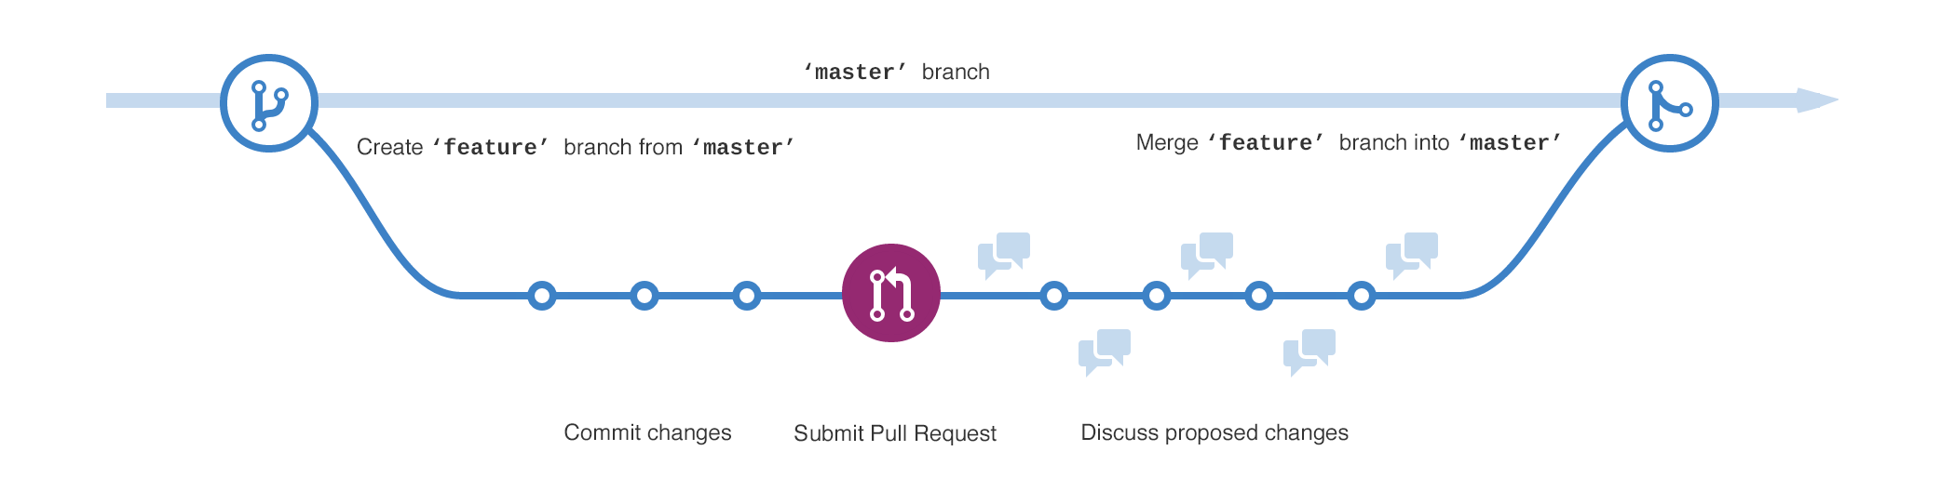
Github Flow

Slide 33
Common UI Tools

Slide 34
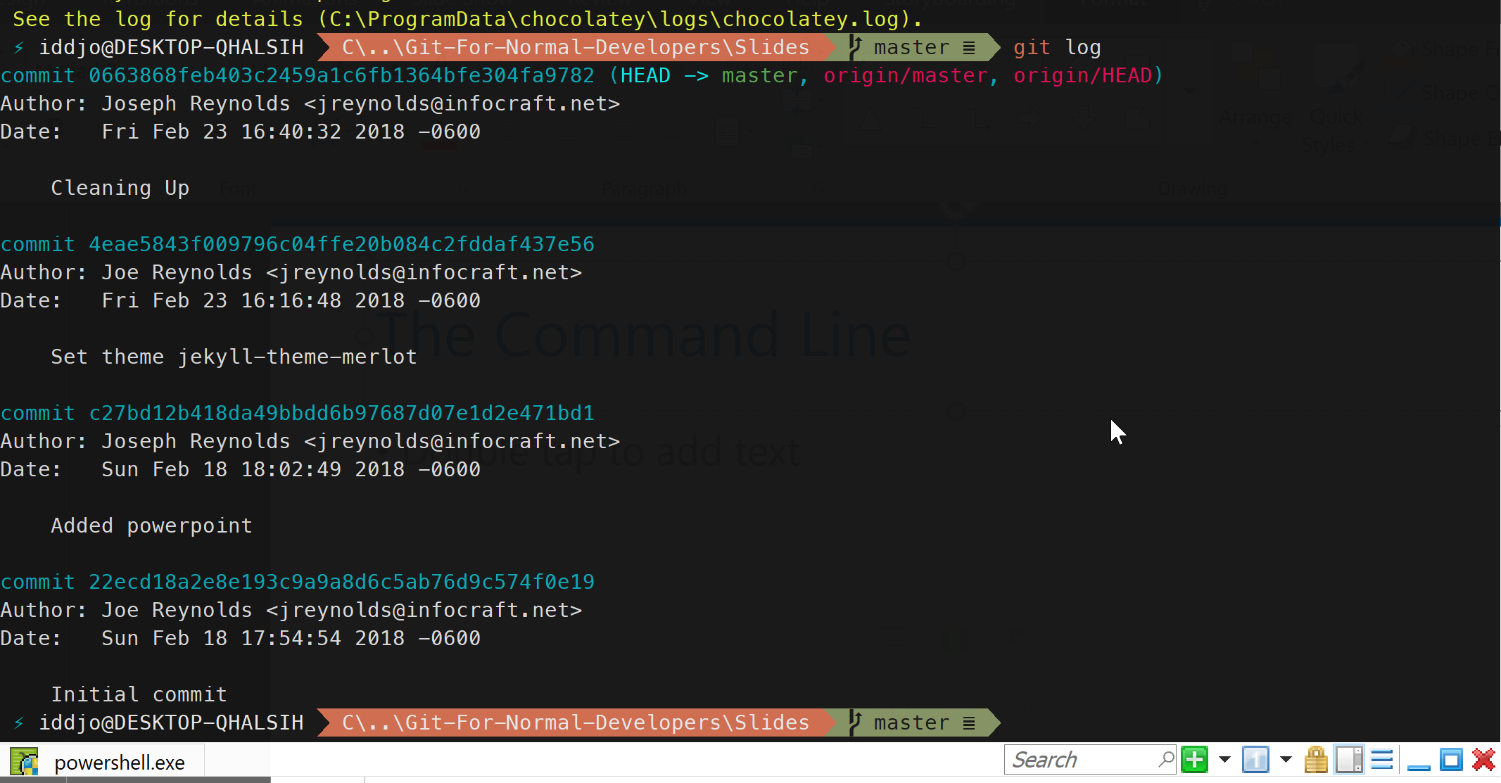
The Command Line

Slide 35
The Command Line
Advantages
Ubiquitous
Easy to find solutions, answers, hints
It’s always there
Disadvantages
It’s the command line.
Seriously though… it’s the command line.

Slide 36
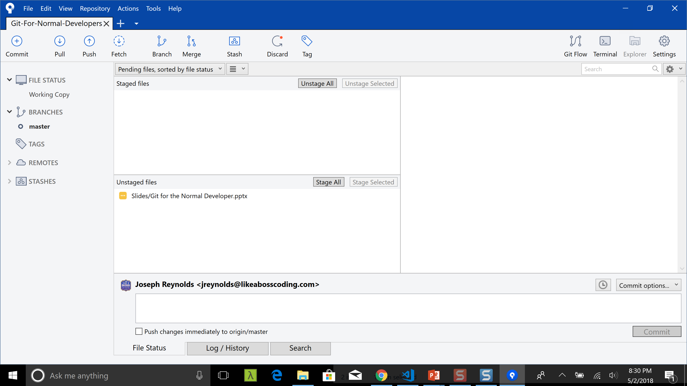
SourceTree

Slide 37
SourceTree
Advantages
Common UI
Easy to use
Multi-Platform
Disadvantages
Seems to update a LOT – this can be a pain
Owned by Atlassian, requires an account

Slide 38
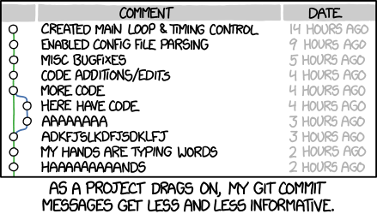

Slide 39
Further Reading
Comparisons of Hosting Platforms
https://www.funkysi1701.com/2017/03/06/github-vs-bitbucket-vs-vsts/
https://www.upguard.com/articles/microsoft-visual-studio-team-services-vs-github
Tips and Tricks
Sync VSTS and Github: https://nkdagility.com/open-source-vsts-tfs-github-better-devops/

